Slide 1
Continual Learning Techniques for Image Classification
Finlay Boyle
Supervised by Dr Donald Sturgeon
Durham University, Department of Computer Science

Slide 2
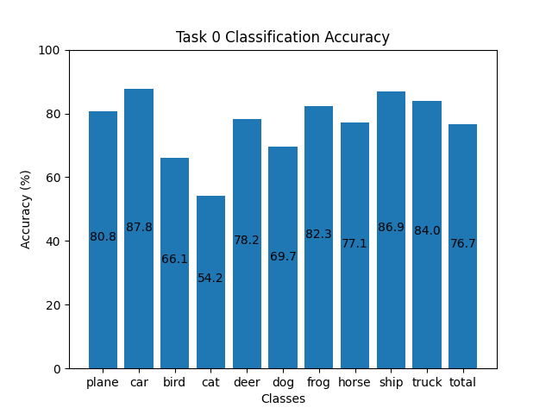
Training Machine Learning Models
Standard method of training models is known as Offline Training
Repeatedly optimise over batches of data from the dataset
Requires access to all of the data for the whole training process
Capable of producing high-quality results
Some limitations exist:
What if the data is not all readily available?
What if it is too expensive or infeasible to store all of the data?
Inspiration for neural networks comes from nature [1] but ability to learn continuously is often overlooked
Figure 1: Offline Training on CIFAR-10 for 100 epochs

Slide 3
Catastrophic Forgetting
Catastrophic Forgetting: a phenomenon were a neural network overwrites any existing knowledge in the network when training on new data [2]
Occurs when naively using Offline Training to update an already trained neural network about new classes sequentially
Offline Training does not preserve the existing knowledge in the network
Training process does not have the context that the existing weights in the network represent prior knowledge
Can view them as an initialisation of the network instead

Slide 4
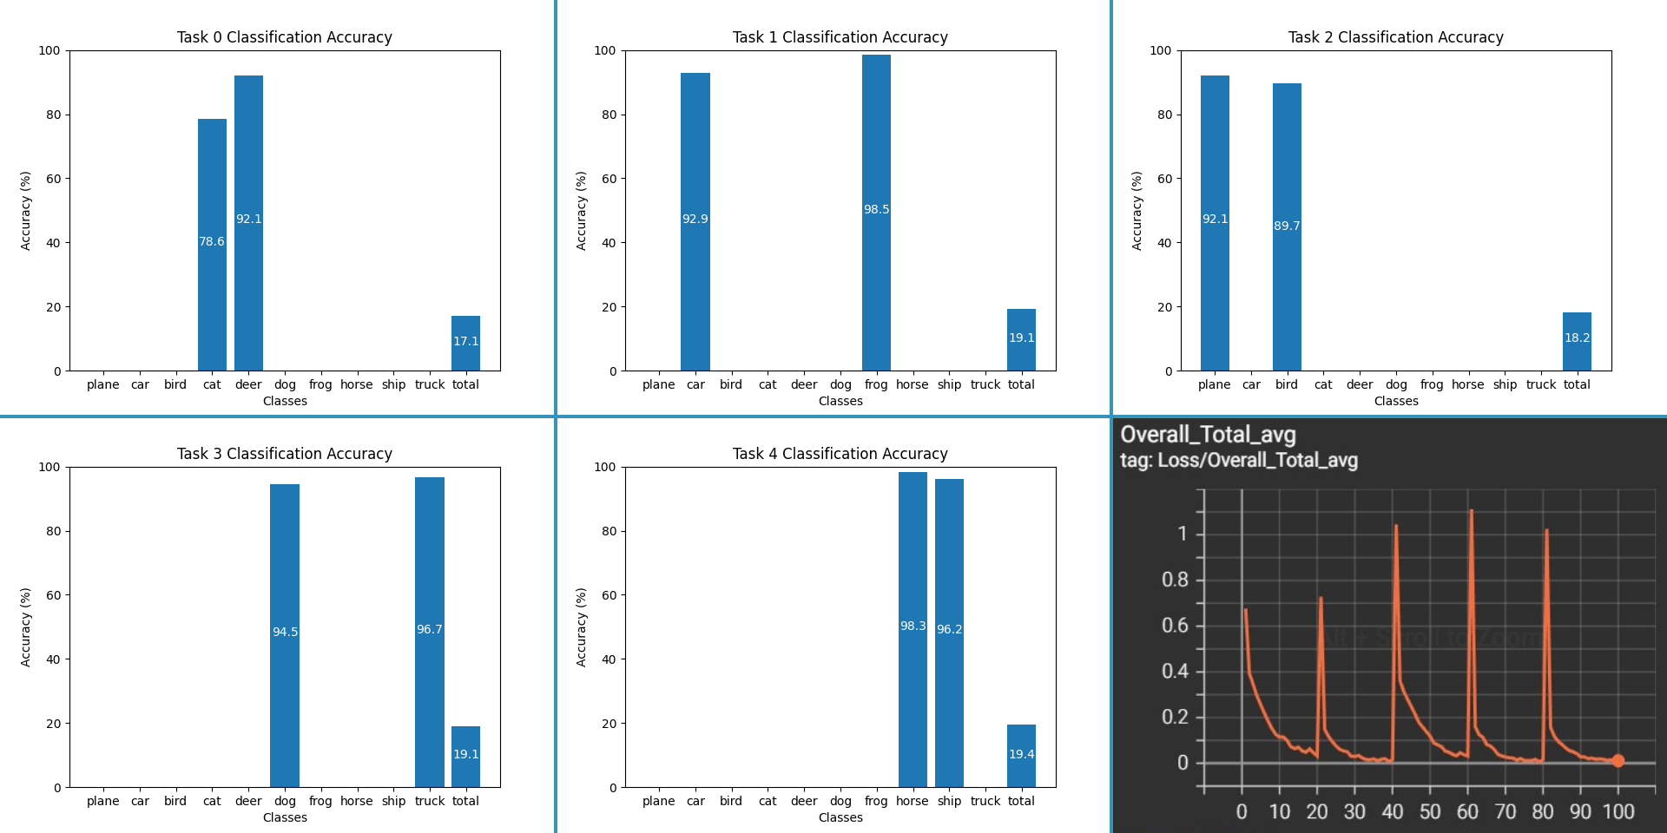
Example of Catastrophic Forgetting
Figure 2: Applying Offline Training on the same model with separate tasks causes Catastrophic Forgetting. Bottom right: Overall loss, other images are classification accuracy

Slide 5
Continual Learning
Continual Learning attempts to overcome Catastrophic Forgetting [3]
Is it possible to train a network sequentially while maintaining knowledge?
Primarily focused on alternative methods to Offline Training
Smaller focus on network architecture and dynamic networks
Difficulty of the Continual Learning problem depends on the setup of the problem
Core difference from Offline Training is the removal of the requirement of the whole dataset
Rose to prominence with Elastic Weight Consolidation in 2017 [4] and is actively researched

Slide 6
Applications of Continual Learning
Continual Learning offers real-world benefits
Models trained on massive amounts of data are expensive to train [5] in terms of energy usage, computational resources, and time
Retraining these models to update them with new data compounds the cost
If they can be updated with Continual Learning this could save computational resources and time such as in Image Classification [6]
Real-time applications can also benefit by adapting to the changing data distribution leading to more accurate results
Research is mainly focused on Image Classification but can be applied to other domains such as Natural Language Processing [7]

Slide 7

Setup for Continual Learning
The setup of the problem for Continual Learning is vital to ensure results are real-world applicable
Issues with the direction of the literature were highlighted by the authors of a simplistic technique called GDumb [8]
Assumptions affecting the setup:
Online vs Offline
Disjoint Tasks vs Non-Disjoint Tasks
Class Incremental vs Task Incremental
Resource Constraints
Figure 3: Disjoint Task Formulation with 3 classes per task
Figure 4: Non-disjoint Task Formulation with all 6 tasks in any order

Slide 8
Part I: Literature Evaluation
My project will initially focus on implementing and evaluating existing techniques from the literature
Aim is to provide a robust comparison between existing methods to solve some of the issues outlined previously
Deliverables:
Implementation of Baselines: Finetuning and Offline Training
Historical Techniques: Elastic Weight Consolidation [4], iCaRL [9]
State of the Art: GDumb [8], Rainbow [10], Mnemonics [11]
Cutting Edge: Learning to Prompt [12] and meta-learning techniques
Evaluation and comparison of techniques

Slide 9
Part II: Novel Experimentation
After literature comparison and evaluation, the focus will shift to gaps in the literature
Aim is to experiment with potential future research areas and potentially create a novel approach.
This will be influenced by the cutting-edge techniques e.g. experimenting with architecture [13] and sampling methods for replay methods
Deliverables:
Establishing a theoretical underpinning to any experimentation to ensure there exists potential
Implementation of experiments and potentially any different approaches found
Evaluation and comparison with techniques from Part I

Slide 10
References
[1] Hecht-Nielsen, Robert. "Neurocomputing: picking the human brain." IEEE spectrum 25.3 (1988): 36-41.
[2] McCloskey, Michael, and Neal J. Cohen. "Catastrophic interference in connectionist networks: The sequential learning problem." Psychology of learning and motivation. Vol. 24. Academic Press, 1989. 109-165.
[3] Parisi, German I., et al. "Continual lifelong learning with neural networks: A review." Neural Networks 113 (2019): 54-71.
[4] Kirkpatrick, James, et al. "Overcoming catastrophic forgetting in neural networks." Proceedings of the national academy of sciences 114.13 (2017): 3521-3526.
[5] Wiggers, Kyle. "AI Weekly: AI Model Training Costs on the Rise, Highlighting Need for New Solutions." VentureBeat, 15 Oct. 2021, https://venturebeat.com/ai/ai-weekly-ai-model-training-costs-on-the-rise-highlighting-need-for-new-solutions/.
[6] Mai, Zheda, et al. "Online continual learning in image classification: An empirical survey." Neurocomputing 469 (2022): 28-51.
[7] Biesialska, Magdalena, Katarzyna Biesialska, and Marta R. Costa-Jussa. "Continual lifelong learning in natural language processing: A survey." arXiv preprint arXiv:2012.09823 (2020).
[8] Prabhu, Ameya, Philip HS Torr, and Puneet K. Dokania. "Gdumb: A simple approach that questions our progress in continual learning." European conference on computer vision. Springer, Cham, 2020.
[9] Rebuffi, Sylvestre-Alvise, et al. “iCaRL: Incremental classifier and representation learning." Proceedings of the IEEE conference on Computer Vision and Pattern Recognition. 2017.
[10] Bang, Jihwan, et al. "Rainbow memory: Continual learning with a memory of diverse samples." Proceedings of the IEEE/CVF Conference on Computer Vision and Pattern Recognition. 2021.
[11] Liu, Yaoyao, et al. "Mnemonics training: Multi-class incremental learning without forgetting." Proceedings of the IEEE/CVF conference on Computer Vision and Pattern Recognition. 2020.
[12] Wang, Zifeng, et al. "Learning to prompt for continual learning." Proceedings of the IEEE/CVF Conference on Computer Vision and Pattern Recognition. 2022.
[13] Mirzadeh, Seyed Iman, et al. "Architecture matters in continual learning." arXiv preprint arXiv:2202.00275 (2022).

